Slide 1


Lecture 8:
Convolutional
Neural Networks
McGill Artificial
Intelligence Society

Slide 2
Today’s Agenda
Convolutions and Sensor Problem
CNNs - Convolution Layer
CNNs - Pooling Layer
CNNs - Fully Connected Layer
Types of CNN Architectures
Regularization in CNNs

Slide 3
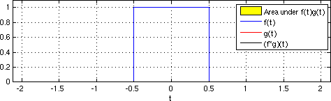
Convolutions
A convolution is a mathematical operation on two functions which produces a third one.
It can be calculated with the following mathematical equation:
s(t) = ∫ f(a)g(t-a)da s(t)=(f*g)(t)

Slide 4
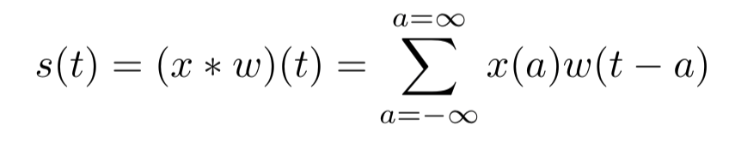
Convolutions
There is also a discrete version of the convolution operation where we replace the integral with the sum.

Slide 5
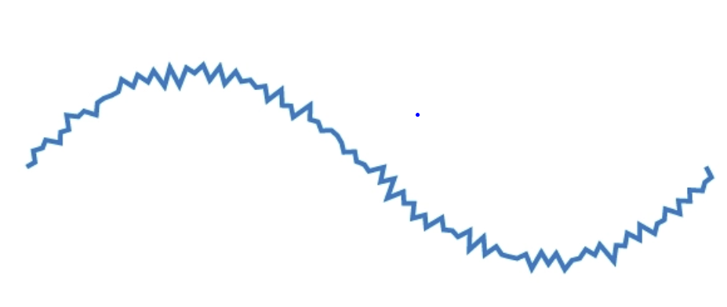

Sensor Problem
Say we have a sensor that outputs a noisy signal.
This signal is time dependent -> x(t)
Convolutions can be used to smooth out this signal. How?
Notes:
Just defining the sensor problem, nothing out of the ordinary

Slide 6


Sensor Problem
We can convolute a signal with our original one to obtain a new smoothened signal, with minimal information loss.
Note that this method takes a weighted average of the most recent data at each point in order to denoise the signal.
g(t)

Slide 7
Sensor Problem
Before, we needed a very complex function to represent this signal.
Now, we can use a simple function (such as sine or cosine).
But how is this related to machine learning ?!?!
g(t)

Slide 8
The Problem With Feed Forward Neural Networks
Take a 256x256 image, that is 65536 parameters
Add a hidden layer with 1000 neurons -> over 65 million parameters
Add two hidden layers with 15000 neurons -> over 1 billion parameters
Call this the curse of dimensionality!
We need a way to represent this data with lower dimensionality, but without losing important information.

Slide 9
The Problem With Feed Forward Neural Networks
In the sensor problem, we took the signal within a time frame and used convolutions to output a more desirable representation of it.
Similarly in images, we can take a neighbourhood of pixels and use convolutions to output a more desirable representation of it too.
In the image context, a desirable representation is one that has minimal information loss and one which can also be easily represented in a lower dimension.
Using convolutions in such a way is what forms the the basis of convolutional neural networks (CNNs).

Slide 10
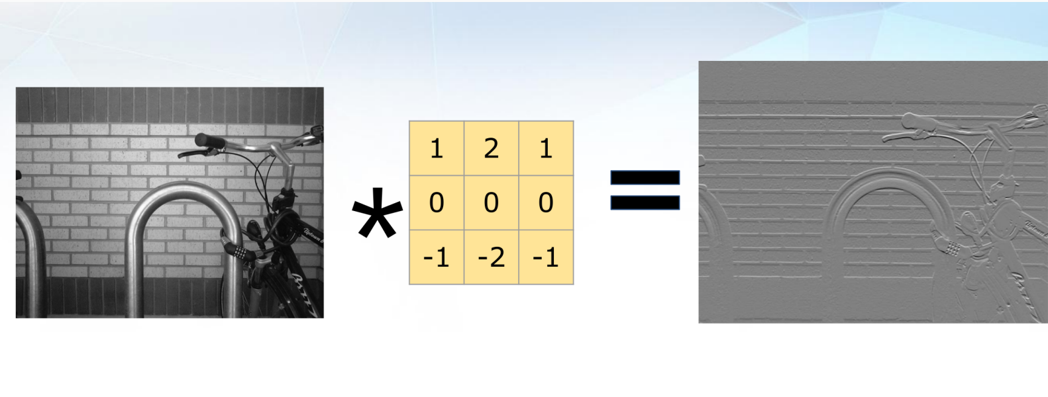
Convolutional Neural Networks (CNNs)
In CNNs, we apply convolutional filters to an image to consider the neighborhood of inputs before considering the correlation of that pixel with those on the other side of the image.
Notes:
Different kernels filter for different things, can be edges, can be colors, can be specific shapes. So if we have a ton of these kernels, we can essentially filter for all the important information in an image.

Slide 11

CNNs - The Big Picture
Convolutional neural networks have 3 stages:
Convolution Layer(s)
Pooling Layer(s)
Classification - Fully Connected Layer

Slide 12
CNNs - The Big Picture
Convolutional neural networks have 3 stages:
Convolution Layer(s)
Pooling Layer(s)
Classification - Fully Connected Layer

Slide 13
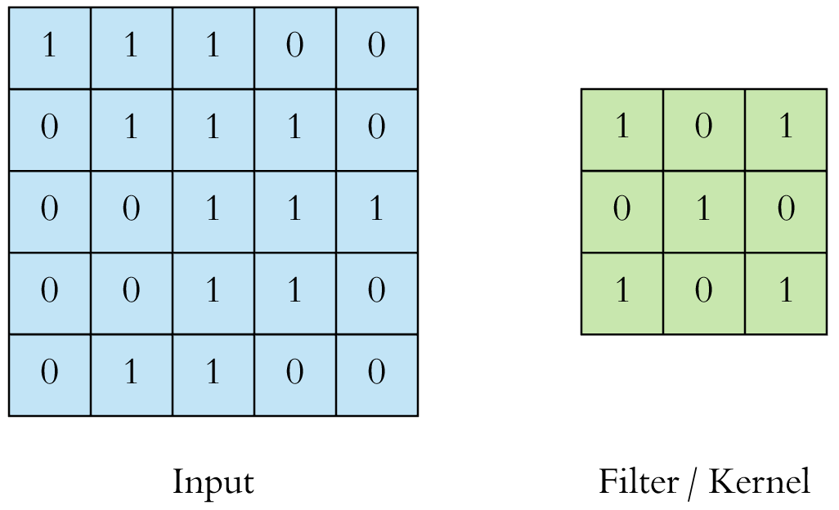
CNNs - Convolution Layer(s)
The goal of a convolution layer is to extract the high level features out from an image using convolutional filters, called the kernel.
A 3x3 kernel is usually used, but a 5x5 and 7x7 can also work depending on applications. This is a hyperparameter to explore.

Slide 14
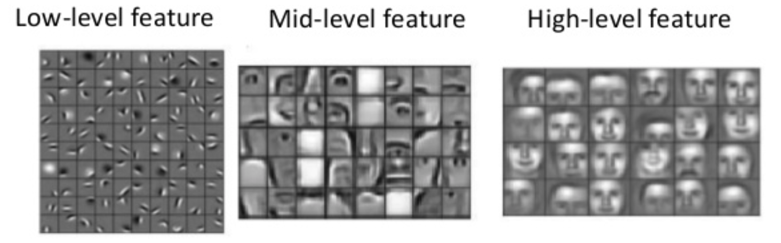
CNNs - Convolution Layer(s)
There can be multiple convolution layers where earlier layers captures low-level features such as edges or colours while added layers capture high-level features such as facial parts.
Below are examples of feature maps created from a convolution layer.

Slide 15

CNNs - Convolution Layer(s)
In CNNs and deep learning in general, the features are learned rather than manually selected during the data preprocessing phase.

Slide 16
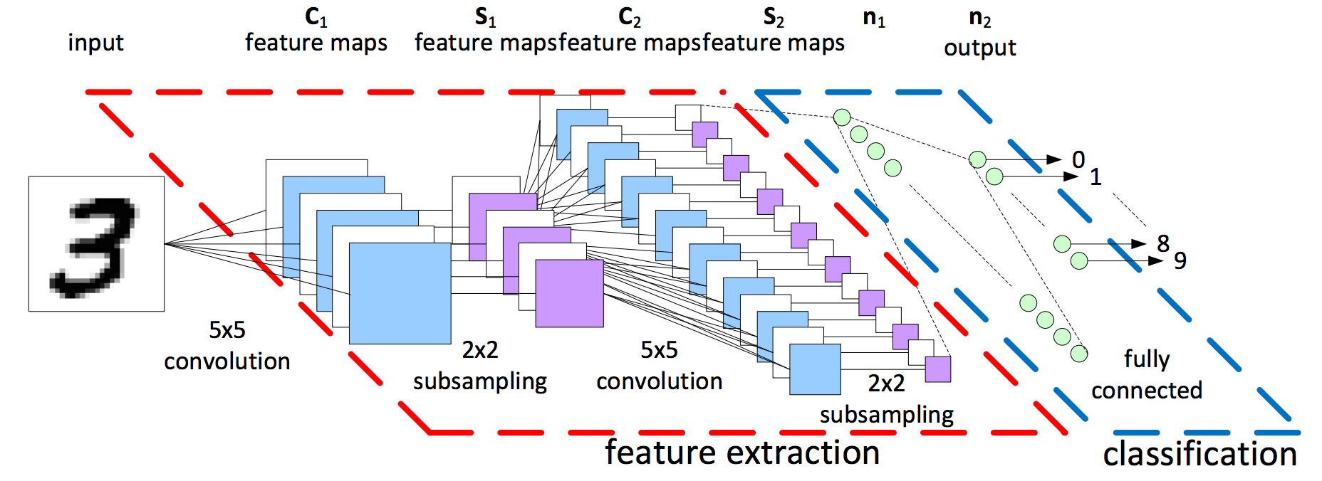
CNNs - Convolution Layer(s)
Each convolution layers helps to extract a different set of features.

Slide 17
CNNs - Convolution Layer(s)
Let’s visualize exactly how a convolution would work.

Slide 18
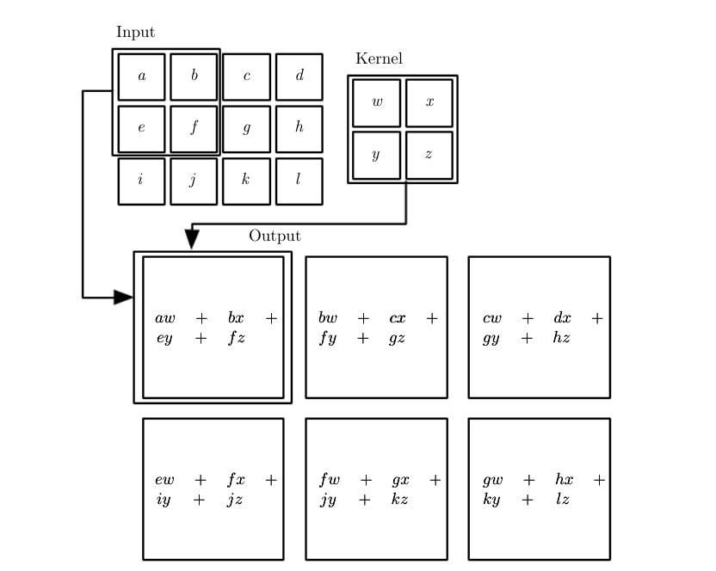
CNNs - Convolution Layer(s)
Let’s visualize exactly how a convolution would work.

Slide 19
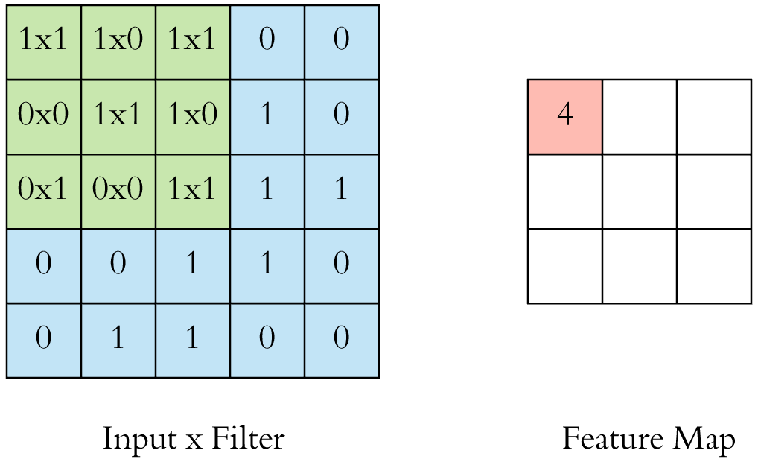
CNNs - Convolution Layer(s)
Let’s visualize exactly how a convolution would work.

Slide 20
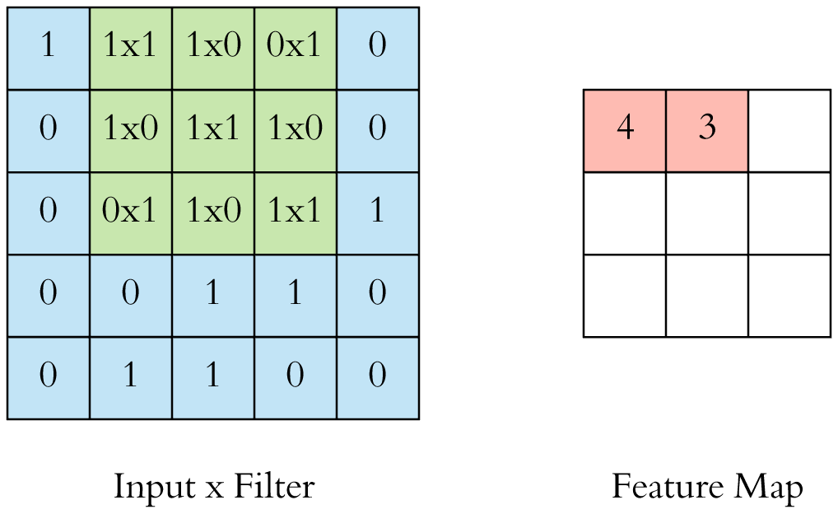
CNNs - Convolution Layer(s)
Let’s visualize exactly how a convolution would work.

Slide 21
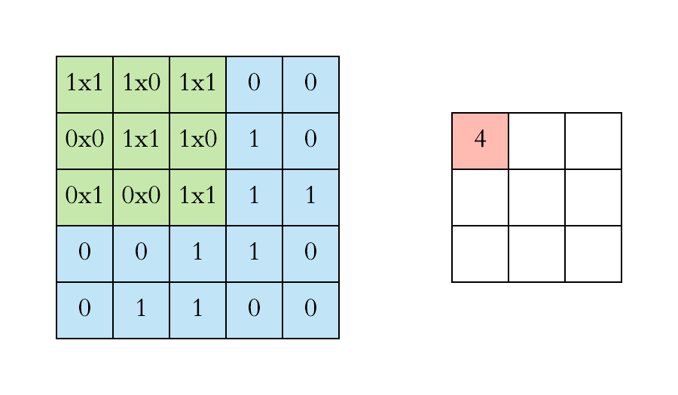
CNNs - Convolution Layer(s)
Let’s visualize exactly how a convolution would work.

Slide 22
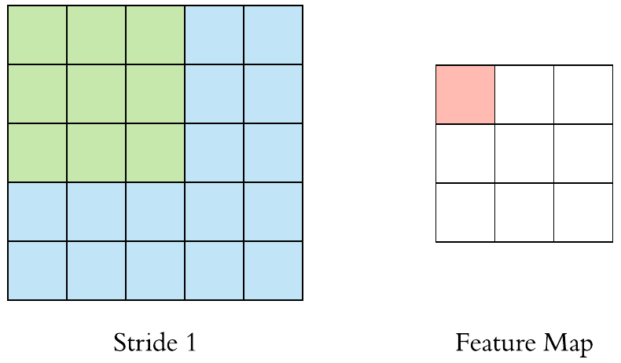
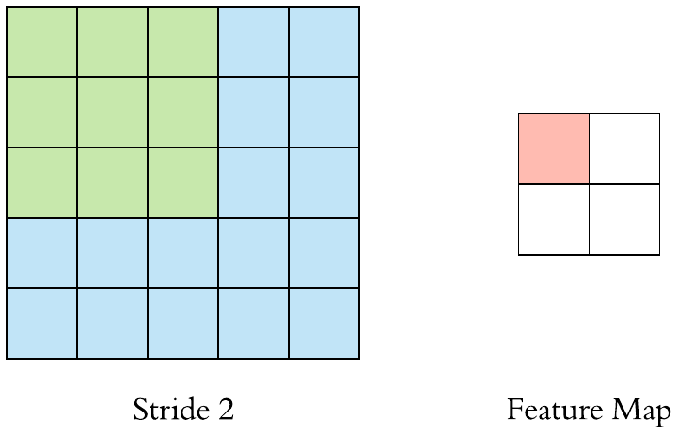
CNNs - Convolution Layer(s)
We can change the stride of the convolution depending on whether we want more or less overlap. (Usually use stride = 1)

Slide 23
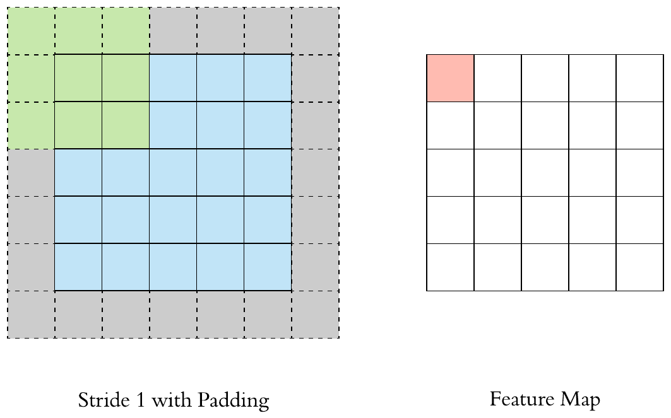
CNNs - Convolution Layer(s)
We usually padding (0 pixels) to the outside of the image to keep the input size the same as its feature map.

Slide 24
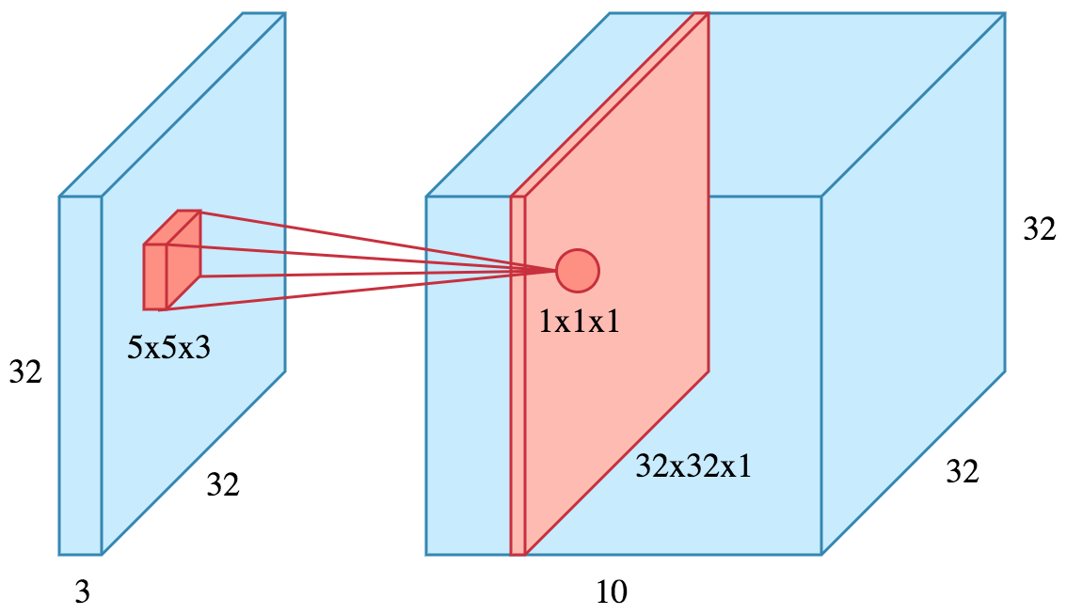
CNNs - Convolution Layer(s)
We perform multiple convolutions on an input, each using a different filter (filter count) and resulting in a distinct feature map.
We then stack them together as the output of our convolution layer.
A quick note that the depth of the convolution filter should match the number of channels of the image (RGB = 3 channels).

Slide 25
CNNs - Convolution Layer(s)
Summarizing the hyperparameters in a convolution layers:
Filter Size - Usually 3x3, but 5x5 and 7x7 can sometimes work.
Filter Count - Most variable parameter but is usually a power of 2 between 32 and 1024. High counts are prone to overfitting. The filter count usually increases at deeper layers.
Stride - Usually 1.
Padding - Usually enabled.

Slide 26
CNNs - The Big Picture
Convolutional neural networks have 3 stages:
Convolution Layer(s)
Pooling Layer(s)
Classification - Fully Connected Layer

Slide 27
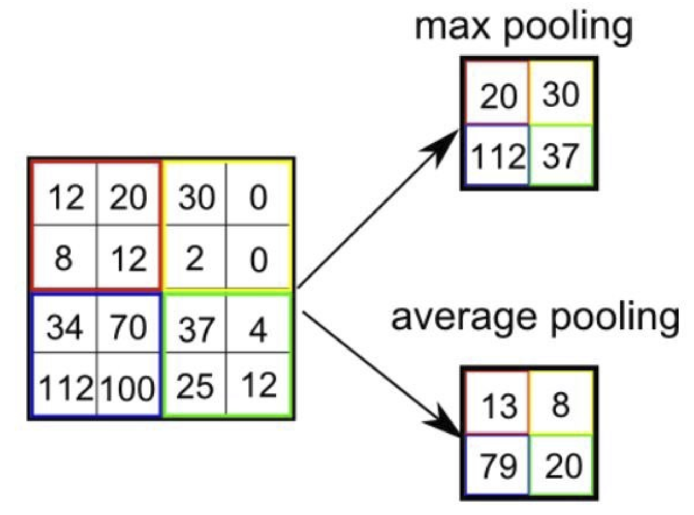
CNNs - Pooling Layer(s)
The goal of a pooling layer is to reduce the spatial size of the convolved feature. There are two main types of pooling layers:
Max pooling returns the maximum value from the portion of the image covered by the kernel.
Average pooling returns the average of all values from the portion of the image covered by the kernel.
L2 norm and weighted average are other types.
Note that the size of the pooling window is another hyperparameter.

Slide 28
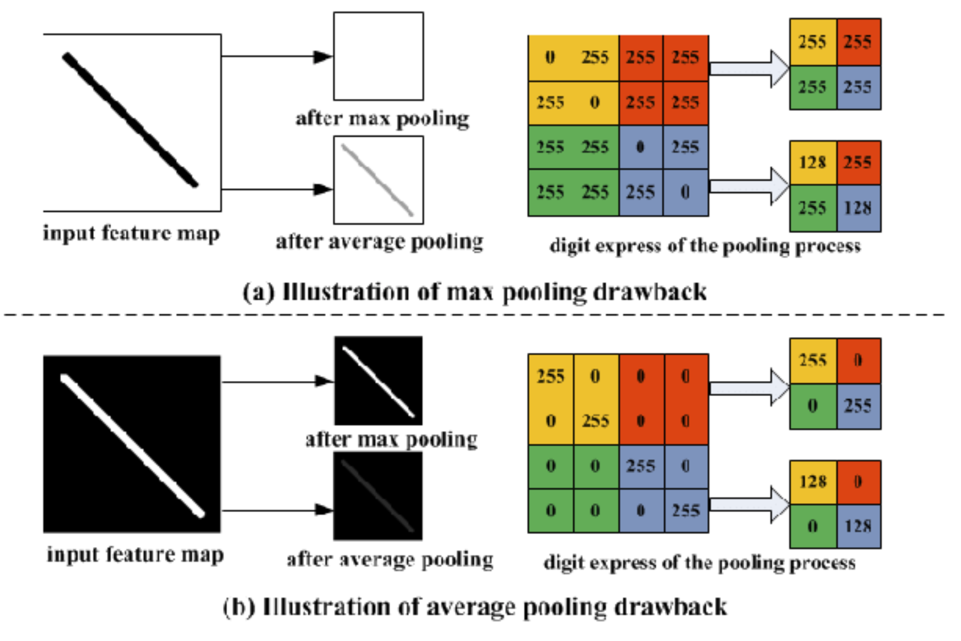
CNNs - Pooling Layer(s)
Max pooling has shown better empirical results, but the type of pooling layer that you use depends on the scenario:

Slide 29
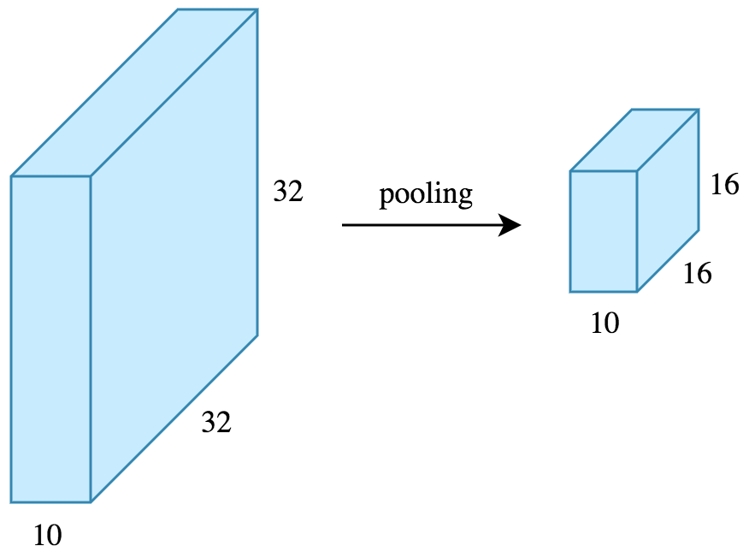
CNNs - Pooling Layer(s)
While pooling reduces the height and width of the feature map, it does not change the depth as pooling performs independently on each depth.

Slide 30
CNNs - Pooling Layer(s)
This helps to reduce the number of dimensions which shortens training time and prevents overfitting.
Dominant features are extracted and thus maintaining the process of effectively training the model.
Essentially the pooling layer takes an area and performs a statistical summary of it.
This allows us to achieve the goal of reducing the number of dimension, but without losing important information.

Slide 31
CNNs - The Big Picture
Convolutional neural networks have 3 stages:
Convolution Layer(s)
Pooling Layer(s)
Classification - Fully Connected Layer

Slide 32
CNNs - Fully Connected Layer
The reduced form of our image is flattened into a column vector and is fed through a feed forward neural network.
The training happens the same way (using backpropagation and gradient descent), but the math is just more complex.
In depth explanation if you are interested.

Slide 33
CNNs - Types of Architectures
There are various state-of-the-art CNN architectures that have been developed and commonly used in real world applications.
Some popular examples include the following:
LeNet
AlexNet
VGGNet
GoogLeNet
ResNet
YOLO

Slide 34
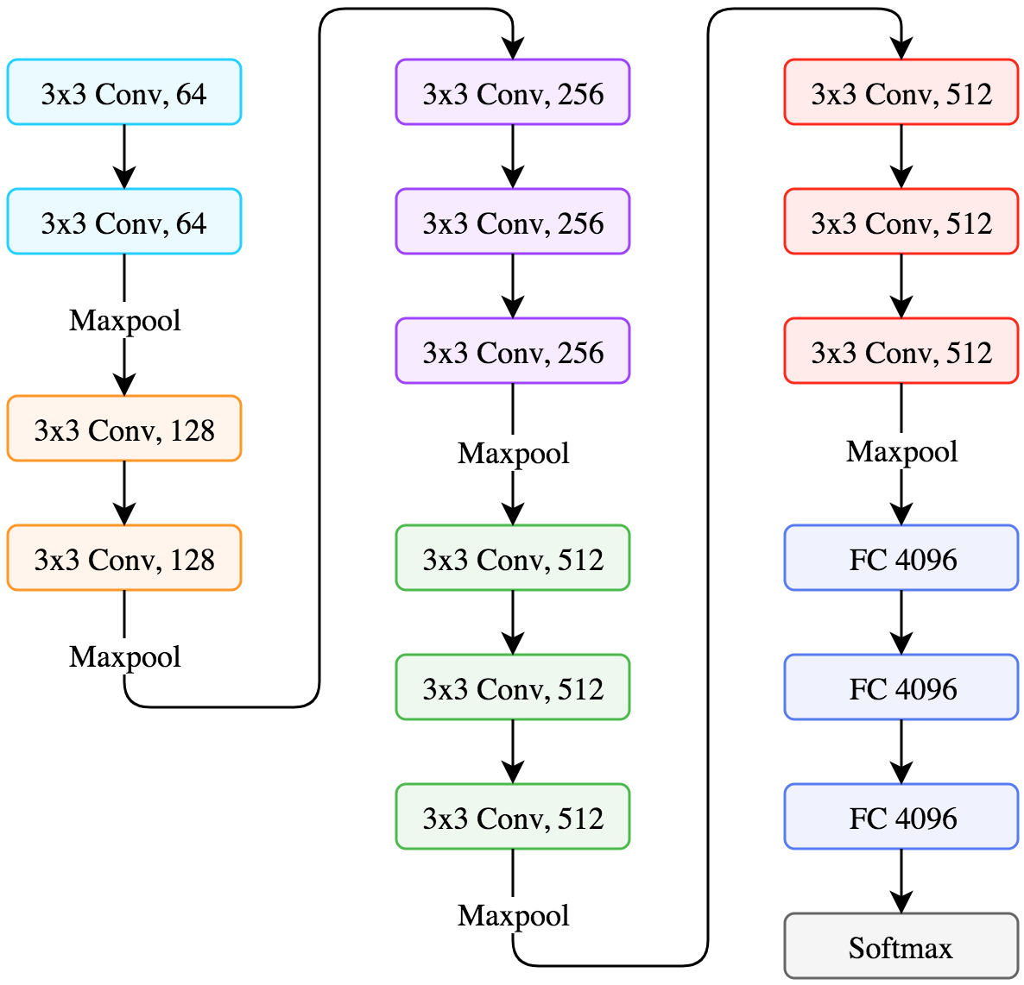
CNNs - Types of Architectures (VGGNet)
Popular network used for object recognition.

Slide 35
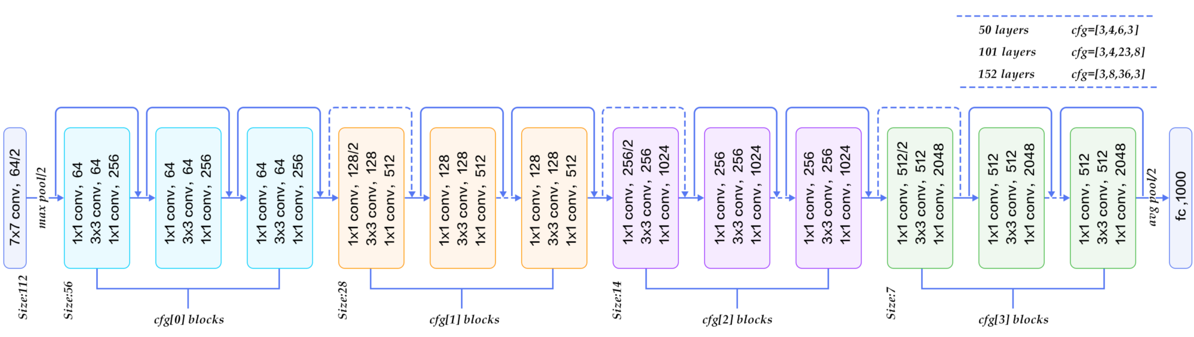
CNNs - Types of Architectures (ResNet)
Introduces identity shortcut connections that skip one or more layers.

Slide 36
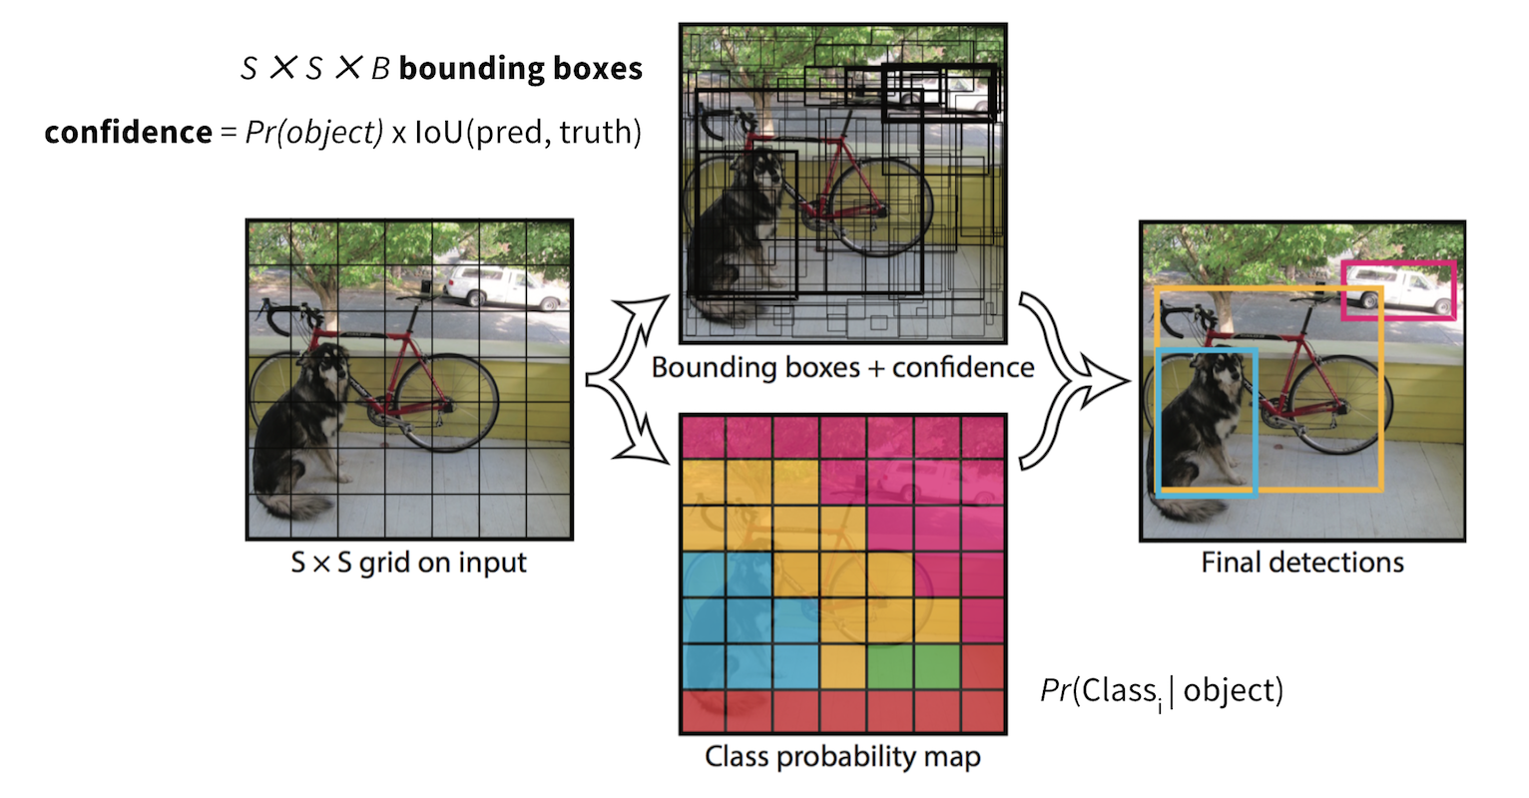
CNNs - Types of Architectures (YOLO)
Performs both localization and classification in one step.

Slide 37
CNN Advantages
Using convolutions give us the following advantages:
Feature Extraction
Automatically captures and learns relevant features.
Lower Computational Load
Reduced dimensionality helps to speed up training time.
Spatial Invariance
Since weights are repeated across space, it does not matter where an object may be located in a photo.
Performance
CNNs are a breakthrough discovery which greatly outperforms traditional ML algorithms in computer vision and other tasks.

Slide 38
Dropout - Regularization Technique
A common regularization technique in deep learning is called dropout.
Let’s imagine a scenario:
You are the only UI developer at a web development company.
Since you go to work everyday and you are very good at your role, no one else has ever bothered to learn how to do your job.
You got sick suddenly, and now the company is in trouble because no one else even knows HTML/CSS/Javascript and there are huge deadlines approaching fast.

Slide 39
Dropout - Regularization Technique
Now imagine a different scenario:
You are the only UI developer at a web development company.
Everyday, you flip a coin to decide whether you will go to work or not. You know you won’t get fired, because your mom is the CEO.
Each time you aren’t at work, someone else does the work that you were responsible for.
You got sick suddenly and there are huge deadlines approaching.
While it is more work, a little bit of extra effort from each person should be enough to help cover for your long absence.

Slide 40
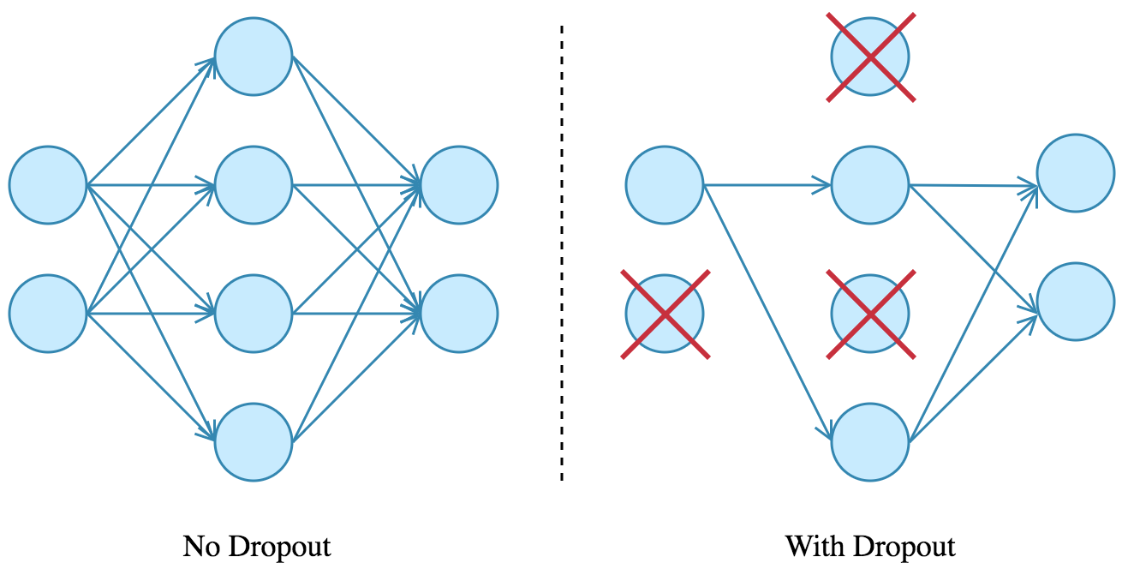
Dropout - Regularization Technique
This is basically the idea of dropout - disabling neurons with probability p so that the network isn’t dependent on one node.
Dropout can be applied to input or hidden layers, but not output.

Slide 41
Further Reading
Alexnet: https://papers.nips.cc/paper/4824-imagenet-classification-with-deep-convolutional-neural-networks.pdf
VGG: https://arxiv.org/pdf/1409.1556.pdf
Resnet: https://arxiv.org/pdf/1512.03385.pdf
Inception-Resnet v4: https://arxiv.org/pdf/1602.07261.pdf
MobileNet: https://arxiv.org/pdf/1704.04861.pdf
YOLOv3: https://pjreddie.com/media/files/papers/YOLOv3.pdf
Original Style Transfer: https://arxiv.org/pdf/1508.06576.pdf
Dropout: http://jmlr.org/papers/v15/srivastava14a.html

Slide 42
Homework Assignment
Convolutional NN Implementation With Keras
Assignment8-CNNs.ipynb

Slide 43
Thanks!
Any questions?
McGill Artificial
Intelligence Society

